Slide 1
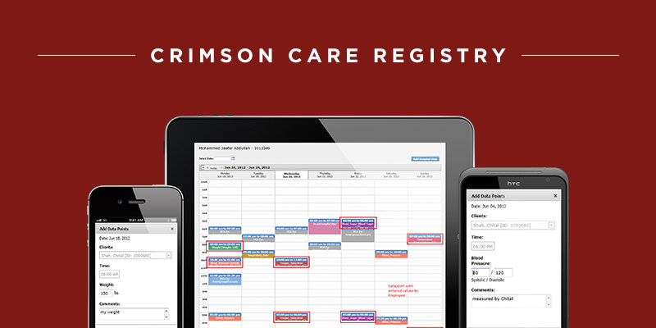
Crimson Care Registry
The Challenge
Advisory Board came to Affirma with the goal of streamlining the care management process. Advisory Board utilizes a care manager to enroll patients in a registry; that manager then contacts each patient by phone once a week to determine his or her status, thereby transitioning care responsibility to the patient. Advisory Board needed a care management tool that would seamlessly integrate with their existing application.
What We Did
Affirma built a care management tool for Advisory Board containing built-in logic which assigns the appropriate care plan to patients based on the individual's specific health issues.
Affirma's in-house development team used .NET to create a web-based tool allowing care managers to access pertinent patient information from an intuitive, easy-to-use interface.
The solution utilizes tracking and reporting services, and is fully integrated into Advisory Board's existing application.
Results
The end solution optimized workflows and processing for care managers and their patients. Advisory Board leveraged Affirma's development team to not only expedite delivery of the care management solution, but also to eliminate workload and time constraints on their in-house team. Affirma's QA team provided automated, comprehensive UI testing, condensing the testing phase from months down to weeks. The client has been extremely happy with the finished product and continues to work with Affirma for ongoing needs

